Slide 1
DISCOVERY AND RE-USE OF SCHOLARLY LITERATURE
COPYRIGHT, LICENSING & ETHICAL CONSIDERATIONS
Research4Life is a public-private partnership of five programmes:

Slide 2
Outline
Intellectual property
Copyright
Fair use
Licensing and access rights
Creative Commons open licenses and public domain
Public domain
Ethical considerations and plagiarism
This work is licensed under Creative Commons Attribution-ShareAlike 4.0 International (CC BY-SA 4.0)

Slide 3
Learning objectives
Describe what is copyrighted and how to avoid copyright infringement
Understand licensing and access rights, including how to use the licensed content
Know the different use regimes that publishers apply for journal articles and books
Describe plagiarism and methods to avoid plagiarism
Notes:
This lesson will help you to understand how copyright works in terms of intellectual property rights, what licences are applied to a research and/or creative work, and what is considered as plagiarism
This lesson also aim to provide you with brief but correct guidance to avoid copyright infringement and unethical behaviour in an academic context.

Slide 4
What Intellectual Property (IP) ?
Intellectual property (IP) refers to creations of the mind, such as inventions; literary and artistic works; designs; and symbols, names and images used in commerce. IP is protected in law by patents, trademarks, industrial design, copyright and related rights which enable people to earn recognition or financial benefit from what they invent or create.
~World Intellectual Property Organization (WIPO)~
Notes:
Established in 1970, World Intellectual Property Organization (WIPO) is global forum for intellectual property (IP) services, policy, information and cooperation
The Intellectual Property (IP) system aims to strike the right balance between the interests of innovators and the wider public interest and also foster an environment in which creativity and innovation can flourish

Slide 5
Background
The importance of protecting IP was first recognized in 1883 at the Paris Convention for the Protection of Industrial Property known as the “Paris Convention”
It was also recognized at the Berne Convention for the Protection of Literary and Artistic Works in 1886, known as the “Berne Convention”
Both treaties are administered by WIPO.

Slide 6
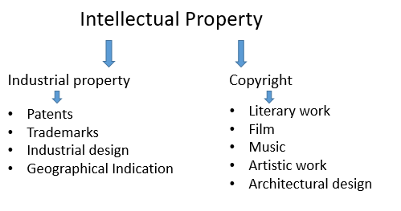
Branches of Intellectual Property
The two branches of IP and works that they protect.
Notes:
Intellectual Property is traditionally divided into two main branches, namely industrial property and copyright.
Industrial Property includes patents for inventions, trademarks, industrial designs and geographical indications.
Copyright covers literary works (such as novels, poems and plays), films, music, artistic works (e.g., drawings, paintings, photographs and sculptures) and architectural design. Rights related to copyright include those of performing artists in their performances, producers of phonograms in their recordings, and broadcasters in their radio and television programs.

Slide 7
Copyright
Copyright is a legal term which refers to the right of the creator.
These rights include:
the right to reproduce the work
the right to prepare derivative works,
the right to distribute copies,
the perform and display the work publicly.
It protects authors, artists and other creators for their literary and artistic creations
Notes:
Copyright is a type of intellectual property that provides exclusive publication, distribution, and usage rights for the creator. This means whatever is created cannot be used by anyone else without the consent of the creator.
Works covered by copyright include, but are not limited to: novels, poems, plays, reference works, newspapers, advertisements, computer programs, databases, films, musical compositions, choreography, paintings, drawings, photographs, sculpture, architecture, maps and technical drawings.

Slide 8
Copyright cont.
Copyright protects 2 types of rights:
Economic rights - allows right owners to derive financial reward from the use of their works by others.
Moral rights - allows authors and creators to take certain actions to preserve and protect their link with their work.
The author or creator may be the owner of the economic rights or those rights may be transferred to one or more copyright owners.
Many countries do not allow the transfer of moral rights.
Notes:
Economic rights covers authorisation or prohibition of reproduction of the work in various forms, such as printed publications or sound recordings; distribution of copies of the work; public performance of the work; broadcasting or other communication of the work to the public; translation of the work into other languages; and adaptation of the work, such as turning a novel into a screenplay.
Moral rights include the right to claim authorship of a work (sometimes called the right of paternity or the right of attribution); and the right to object to any distortion or modification of a work, or other derogatory action in relation to a work, which would be prejudicial to the author’s honor or reputation (sometimes called the right of integrity

Slide 9
How long does copyright last?
It depends on several factors e.g. the type of work, whether the work has been published or not, and whether the work was created by an individual or a corporation
As a general rule, copyright protection for published literary, dramatic and musical works lasts for the life of the author plus an additional 50-70 years.
Notes:
Copyright protection of a work has a duration.
The duration of copyright provided in national law is, as a general rule, the life of the author plus not less than 50 years after the author’s death. There is a trend in a number of countries to lengthen the duration of copyright to the life of the author plus 70 years after the author’s death.
Copyright protection always expires at the end of the calendar year, i.e. December 31, that the copyright is set to expire

Slide 10
Fair use
Permits the use of copyrighted works without seeking permission or approval from copyright holder.
There are no obligations to compensate the right owner for the use of the work without permission.
E.g. quoting from a protected work, provided that the source of the quotation and the name of the author are mentioned, and that the extent of the quotation is compatible with fair practice.
In many license agreements, uses for educational purposes fall under Fair Use
Notes:
Fair use or Fair dealing is recognized in many countries.

Slide 11
Licensing and access rights
A license is a contractual agreement between the copyright owner and user that limits how the user can use the work.
Licensing means that the copyright owner retains ownership but authorizes a third party to carry out certain acts covered by the economic rights, for a specific period and purpose.
Copyright owners may:
transfer ownership of the rights to another person
grant permission to the ‘licensee’ to perform some act in respect of copyright that would otherwise be an infringement of the owner’s copyright.
Notes:
Authors usually agree on exclusive transfer of their rights to publishers, and the publishers/database providers offer non-exclusive licences to the users through universities, research institutions and libraries for their paid content.

Slide 12
Licensing and Research4Life
License agreements are signed by Research4life eligible institutions and publishers.
The agreement includes the terms of use, copyright and fair use.
Librarians are responsible for managing the licensing process so at to avoid any copyright infringement.
Libraries provide guidance and training on using resources adhering to copyright and terms of agreement indicated in their licenses
Notes:
These licences between the publishers and the institutions contain terms and conditions of use associated with the content. The licence agreement covers who is allowed to access the content, what you and your users can and can’t do, and responsibilities of the licensee and the licensor.
The licence agreement between a publisher and a library/institution is confidential and exclusive to the particular institution. Therefore, each particular agreement should be managed separately with care

Slide 13
Creative Commons open licenses
Creative Commons (CC) was established in 2001.
CC is known as a “some rights reserved” license rather than the “all rights reserved” approach.
CC provides tools to assign the appropriate license on a work in the digital environment.
CC tools allow sharing of creative or intellectual work with free, easy-to-use copyright licenses in a standardized way on conditions of your choice
Source:https://creativecommons.org/about/downloads/ Accessed 10 April,2020
Notes:
CC licences are available in English by default and they are translated into other languages. Earlier version of CC licences are adapted in other national legal systems but 4.0 version is international by default.
Author of scientific work should anticipate future uses of their work such as sharing work with colleagues, distributing at conferences, self-publishing on personal website or in a repository, republishing by adaptation or translation, using in class and course packs
Therefore, when they sign copyright agreement/contract with publishers or organizations, they should retain the appropriate rights to copy, share and modify

Slide 14
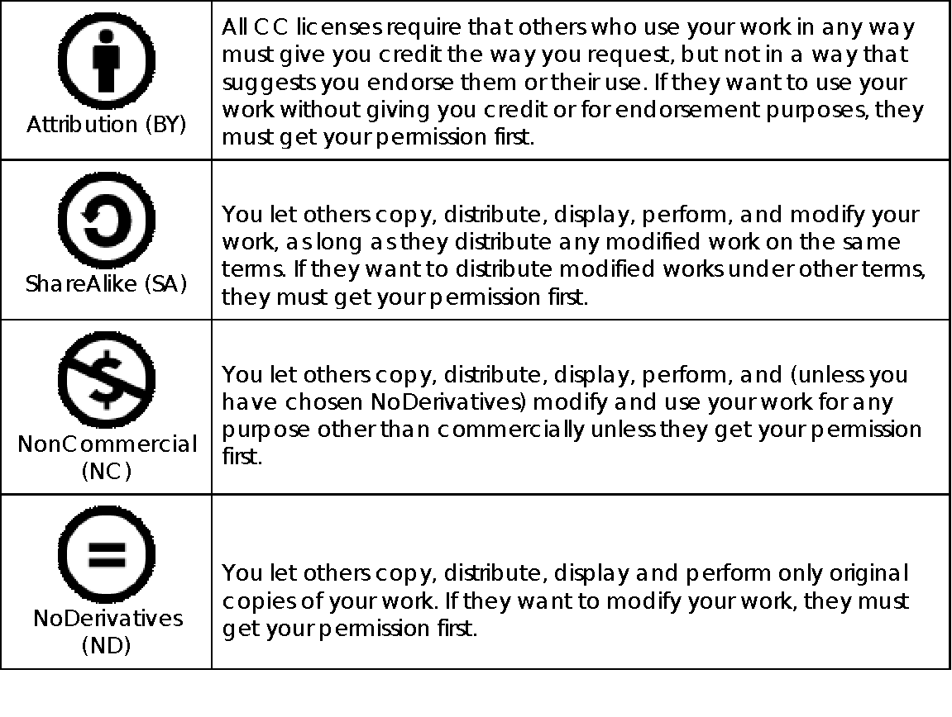
Creative Commons License Conditions
Notes:
Creative Commons licenses consist of four conditions

Slide 15
Creative Commons Licenses
 | Attribution CC BY
 | Attribution- ShareAlike CC BY -SA
 | Attribution- NonCommercial CC BY –NC
 | Attribution- NoDerivatives CC BY –ND
 | Attribution- NonCommercial- ShareAlike CC BY -NC- SA
 | Attribution- NonCommercial-NoDerivatives CC BY –NC-ND
Notes:
Based on the four conditions discussed above, six combination of CC licenses are offered by Creative Commons. Among these licenses, CC BY and CC BY-SA have no limitations on reuse of the work. BY-NC, BY-ND, BY-NC-SA, and BY-NC-ND allow limited uses such as commercial use, derivative work is not allowed
This license lets others distribute, remix, tweak, and build upon your work, even commercially, as long as they credit you for the original creation.
This license lets others remix, tweak, and build upon your work even for commercial purposes, as long as they credit you and license their new creations under the identical terms.
This license lets others remix, tweak, and build upon your work non-commercially, and although their new works must also acknowledge you and be non-commercial, they don’t have to license their derivative works on the same terms.
This license allows for redistribution, commercial and noncommercial, as long as it is passed along unchanged and in whole, with credit to you.
This license lets others remix, tweak, and build upon your work non-commercially, as long as they credit you and license their new creations under the identical terms.
This license is the most restrictive of our six main licenses, only allowing others to download your works and share them with others as long as they credit you, but they can’t change them in any way or use them commercially.

Slide 16
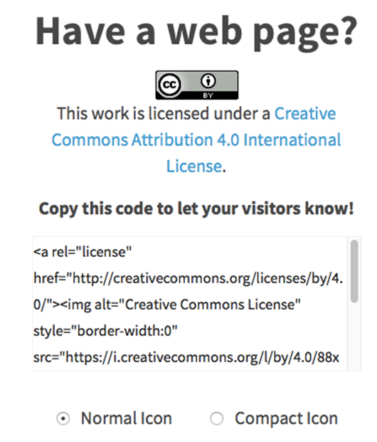
Choosing a license
Choose a CC license that is most relevant to your situation.
Visit the Creative Commons website https://creativecommons.org/choose/
Answer a simple set of questions
Once you complete it, you are given the html code and the logo to embed onto your site.
Source: https://creativecommons.org/choose/ Accessed: 10 April 2020
Notes:
Steps to obtain a CC license can be integrated with the submission process of an institutional repository. This allows users to adopt a CC license for their work while they submit their work. Technical information about the integration can be found in repository software sites such as Dspace.

Slide 17
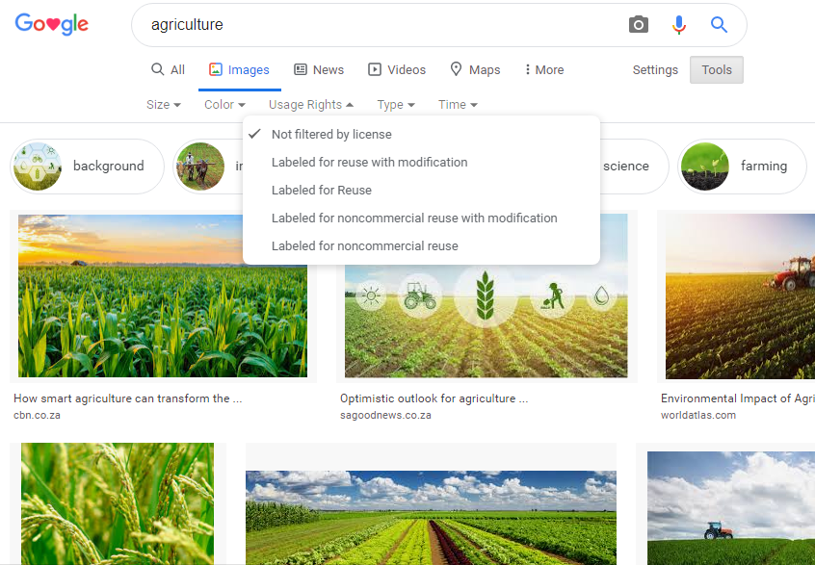
Licensing in research & education
It is important to know where & how to find CC licensed works.
Creative Commons provides a tool to enable users to discover licensed works.
E.g. Google allows one to filter results with the usage rights to retrieve CC licensed works
This helps in finding CC licensed images or videos to use in a conference presentation or in a lecture
A search for a CC licensed image via Google images
Source: Google Images, Accessed 15 April 2020
Notes:
Go live

Slide 18
Public domain
A creative work can be in the public domain.
This means that it belongs to or is available to the public & not subject to copyright or legal restrictions.
No permission is needed to use any material in the public domain.
However, these may be protected by the copyright law & using the collection in its entirety needs permission from the copyright owner

Slide 19
Public domain cont.
Materials can enter into the public domain in the following ways:
the copyright has expired
the copyright owner failed to follow copyright renewal rules
the copyright owner deliberately places it in the public domain, known as “dedication,” or
copyright law does not protect this type of work

Slide 20
Creative Commons (CC) public domain tools
Individuals can choose to waive all of the rights to their work and place the work in the public domain. They can use a CC tool to dedicate their works as CC0 “No rights reserved”. In research and academia, CC0 is the most relevant in managing research data.
CC also provides a public domain mark (PDM) for anyone which such knowledge to tag a work which is no longer restricted by copyright. The allows the work to be easily discoverable.
A number of resources are available for searching public domain works, such as Europeana Collections, Internet Archive, Wikimedia Commons and Project Gutenberg.

Slide 21
Plagiarism defined
Plagiarism is the act of using someone else’s words, ideas or other work without clearly citing the source of that information. It may be intentional or unintentional.
Plagiarism may lead to:
rejection and retraction from publications and conferences.
loss of credibility and professional standing
expulsion from a university or loss of a job
Notes:
Plagiarism is an ethical issue.
Regardless of the area of your work, you have an ethical responsibility when conducting research
Plagiarism is theft of intellectual property.
It does not matter if the person whose work you have cited is alive or dead. If it is not your own idea, you must cite your source!
If you translate or paraphrase something, you must still give a citation.
If you use a picture from the Internet, you must cite the source.

Slide 22
Plagiarism defined cont.
Two behaviors of plagiarism;
submitting someone else’s text as one’s own or attempting to blur the line between one’s own ideas or words and those borrowed from another source
carelessly or inadequately citing ideas and words borrowed from another source
Notes:
Two behaviors of plagiarism according to the Council for Writing Program Administrators

Slide 23
Types of plagiarism
Stealing: If you take a sentence, or even a unique turn of phrase, and pass it off as your own, this is stealing.
Patchworking: Using words and phrases from a source text (that may or may not be acknowledged) and patch them together into new sentences.
Insufficient Paraphrasing: Taking an author's words and changing them slightly, without quoting the actual text, is plagiarism.
Misquoting: When you quote another author in your own work, always be sure to quote exactly what was said. Direct quotes are when you use an author's exact words. Indirect quotes are when you report the spoken or written words of an author, but not his/her exact words. Both must be cited!
Duplicating Publications/Self plagiarism: You cannot reuse/recycle your own paper for use in another assignment without explicit permission from the instructor. If you cite your previous work, remember to cite yourself. This is self-plagiarism

Slide 24
Plagiarism software
Many universities now use plagiarism checking software.
These help detect plagiarism of the works by their students, faculty and staff.
This software allows large numbers of documents to be compared to facilitate detection.
Some are free & some come at a cost.
Examples of plagiarism software
Notes:
https://www.turnitin.com/
https://www.grammarly.com/
https://prowritingaid.com/
https://www.whitesmoke.com/

Slide 25
Summary
This lesson introduced copyright, how it works in terms of Intellectual Property rights and how to avoid copyright infringement
The lesson also described licensing, access rights as well plagiarism.

Slide 26
You are invited to;
Visit us at www.research4life.org
Contact us at r4l@research4life.org
Find out about other training materials [www.research4life.org/training]
Subscribe to Research4Life newsletter [www.research4life.org/newsletter]
Check out Research4Life videos [https://bit.ly/2w3CU5C]
Follow us on Twitter @r4lpartnership and Facebook @R4Lpartnership

Slide 27
For more information on Research4Life
www.research4life.org
r4l@research4life.org
Research4Life is a public-private partnership of five programmes:

