Slide 1
DISCOVERY AND RE-USE OF SCHOLARLY LITERATURE
CITING, REFERENCE MANAGEMENT AND
COLLABORATION TOOLS
Research4Life is a public-private partnership of five programmes:

Slide 2
Outline
Why cite and reference
How to cite and reference
What to cite
Paraphrasing
Summarizing
Quoting
Citation styles
Reference management tools
Zotero
Mendeley
This work is licensed under Creative Commons Attribution-ShareAlike 4.0 International (CC BY-SA 4.0)

Slide 3
Learning objectives
Understand the concept of citing a copyrighted work in relation to plagiarism
Become familiar with commonly used citation styles
Know why, when and how to cite
Use citation styles in office operation in ms word and google doc
Become familiar with reference management tools
Use web versions of mendeley/zotero as an example of such tools
Collaborate with their peers by using such tools
Notes:
This lesson will focus on how and when to acknowledge and attribute the original work of others.
Learners will learn about different citation and citation styles as well as become familiar with reference management softwares

Slide 4
Why should you cite and reference ?
Why should I cite ?
The answer is simple:
Any information which is not from your experiment and not ‘common knowledge’ should be acknowledged with a citation.
Should I cite everything ?
Nope! There is not need to cite facts that are widely known, or
information or judgments considered “common knowledge”
Notes:
When writing a research assignment, thesis or other kind of written work, you need to incorporate information, ideas and argumentation which has already been articulated by others
Whenever you draw upon previously published work in this way, you must acknowledge the source.
Any information which is not from your experiment and not ‘common knowledge’ should be acknowledged with a citation
Common knowledge refers to information that the average person would accept as reliable without having to look it up, but if in doubt always cite the source

Slide 5
Why is it important ?
According to Wageningen University and Research (WUR) Library, it is important to cite & reference in order to:
distinguish your own ideas and findings from those of others,
support your arguments and criticisms,
allow readers to locate and verify your sources,
give authors of these sources credit for their work,
avoid plagiarism

Slide 6
How to cite and reference
Citing and referencing has two key elements:
An in-text marker, the citation that indicates to the reader that a particular concept, phrase or idea is attributable to someone else;
Complete reference list – gives citation details for all sources referred to in the document.
Notes:
The manner in which you are required to write the in-text citation and the references in the list is determined by the citation styles chosen

Slide 7
Two common referencing styles
The note/numbered style - involves the use of sequential numbers as in-text markers that refer to either footnotes or endnotes.
Footnotes are included at the bottom of each page; endnotes are notes on a separate page at the end of a paper.
Parenthetical referencing - involves the use of a partial reference contained within parentheses as the in-text citation (such as the author and date).
The complete reference is then included in a list at the end of the document.
Notes:
Parenthetical referencing is also known as author–date or Harvard referencing. Parenthetical systems can also involve numbering in which in-text citations consists of a number and the references are listed in numerical order in the reference list at the end of the document

Slide 8
What to cite.
It is important to cite the source as close to the original source as possible !
the right of author should be acknowledged and attributed
You can use somebody else’s information or ideas in your own words
Paraphrasing or Summarizing
You can use the exact words of the original source.
Quoting

Slide 9
Paraphrasing, Summarising & Quoting
According to the Purdue Online Writing Lab, a quotation, paraphrase, or summary serves to:
provide support for your claim(s) or add credibility to your writing,
refer to work that leads up to the work you are now doing,
give examples of several points of view on a subject,
draw attention to a position that you wish to agree or disagree with,
highlight a particularly striking phrase, sentence, or passage by quoting the original,
distance yourself from the original by quoting it in order to indicate to the readers that the words are not your own,
expand the breadth or depth of your writing

Slide 10
Steps to follow when quoting, summarizing and paraphrasing
Read the entire text, noting the key points and main ideas,
Summarize in your own words what the single main idea of the essay is,
Paraphrase important supporting points that come up in the essay,
Consider any words, phrases, or brief passages that you believe should be quoted directly.

Slide 11
Paraphrasing
Paraphrasing involves putting the author’s words into your own words. Paraphrased material is usually shorter than the original passage.
Paraphrase when:
You want to avoid overusing quotations
You want to use your own voice to present information

Slide 12
Example
Original text: There is nothing in the nature of vaccines and serums for the protection of the livestock. It is true that all kinds of diseases are to be found here and there among the plants and animals of the forest, but these never assume large proportions. The principle followed is that the plants and animals can very well protect themselves even when such things as parasites are to be found in their midst.”
Source: Howard, A. (1940) An Agricultural Testament. Oxford University Press, London, p.4.
Paraphrase: Howard (1940, p.4) recognizes that diseases of plants and animals do occur in nature, but never on a large scale. Plants and animals develop their own defence mechanisms against pathogens.

Slide 13
Summarizing
Summarizing involves putting the main idea(s) into your own words, including only the main point(s). Once again, it is necessary to attribute summarized ideas to the original source.
Summaries are significantly shorter than the original and take a broad overview of the source material.
Summarize when:
You want to establish background or offer an overview of a topic
You want to describe knowledge (from several sources) about a topic
You want to determine the main ideas of a single source

Slide 14
Example
Original text: “The principle followed is that the plants and animals can very well protect themselves even when such things as parasites are to be found in their midst. Nature’s rule in these matters is to live and let live.”
Source: Howard, A. (1940) An Agricultural Testament. Oxford University Press, London, p.4
Summary: The key concept of organic farming explained by Howard (1940) also included the idea of self-regulation in nature.

Slide 15
Quoting
Quotations are the exact words of an author, copied directly from a source, word for word and must be attributed to the original author. The in-text citation must include the page number or other location information instead where the quotation can be found.
Use quotations when:
You want to add the power of an author’s words to support your argument
You want to disagree with an author’s argument
You want to highlight particularly eloquent or powerful phrases or passages
You are comparing and contrasting specific points of view
You want to note the important research that precedes your own
Notes:
Short direct quotations must be put within quotation marks. Long direct quotations (also called block quotations) are not enclosed by quotation marks, but separated from the rest of your text, often indented and in a smaller font size:

Slide 16
Example
Example short quotation:
According to Howard (1940) in nature, the "rule in these matters is to live and let live" (p.4).
Example block quotation:
Howard (1940) explained a key concept of organic farming. This concept also included the idea of self-regulation in nature:
“Nature has never found it necessary to design the equivalent of the spraying machine and the poison spray for the control of insect and fungous pests. There is nothing in the nature of vaccines and serums for the protection of the livestock. (Howard 1940, p.3).”

Slide 17
Citation styles
These vary from discipline to discipline.
Moreover, the information manager in your institution can be of great help in identifying the style and tools to use.
The mostly used citation styles are;
MLA style – It is published by the Modern Language Association of America.
APA style – It is published the American Psychological Association.
CMOS style – It is published by the University of Chicago Press.
Notes:
The Purdue University Online Writing Lab provides a comparison of MLA, APA and CMOS on a chart which shows the specific use of each style with examples.

Slide 18
Reference management tools
Reference management tools help users to create and manage reference lists for research projects and papers.
These tools organize citations into specific formats for the preparation of manuscripts and bibliographies.
Two frequently used free management software are: Zotero and Mendeley.
These are available online and as stand alone versions that can be installed on a computer.

Slide 19
Zotero
Zotero is a free and open-source reference management tool
It available as an add-on for the Firefox web browser. A stand-alone version is available for Chrome, Safari and Firefox browsers.
Zotero recognizes bibliographic information on books, journal articles, and other resources from websites and databases and extracts metadata from these sources.
It allows one to;
store related PDFs, files, images, and links in your library,
create a reference list in Microsoft Word or OpenOffice,
publish shared libraries for your organization or research group.

Slide 20
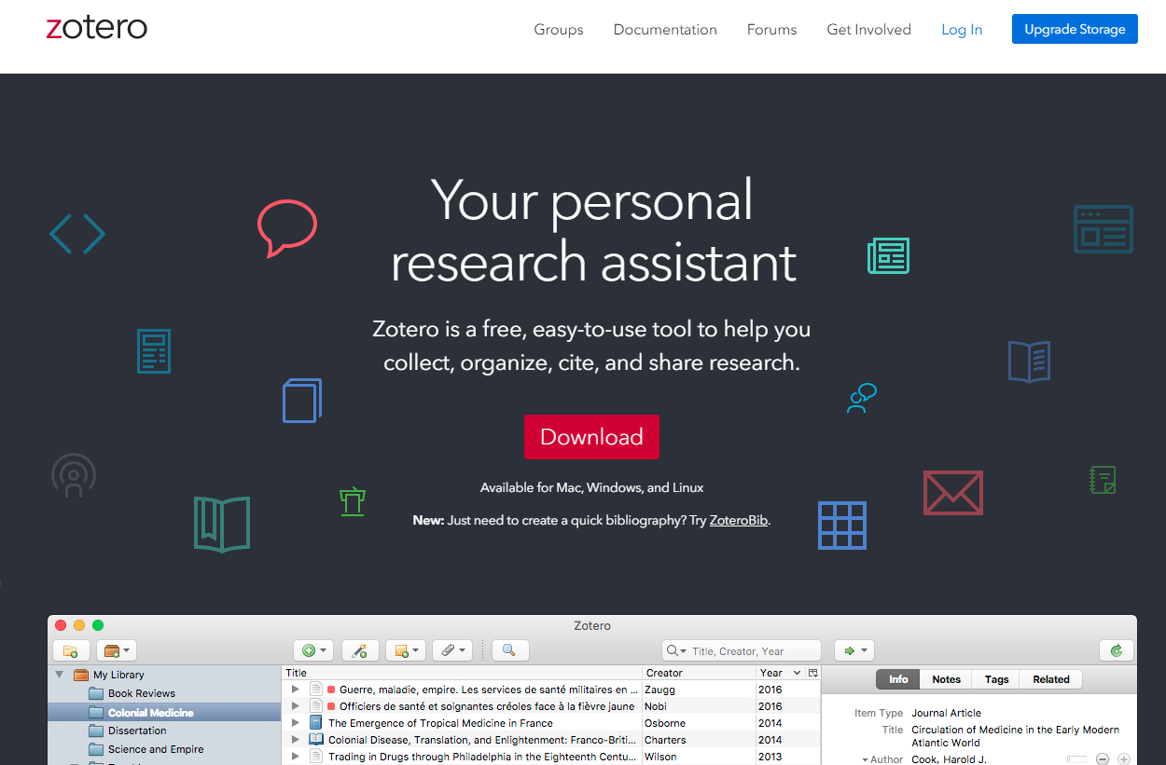
Zotero cont.
A comprehensive how to use guide is available through the research4life website
Web access to the software: http://www.zotero.org
Desktop version to download: https://www.zotero.org/download/
Guides: https://www.zotero.org/support/
Source: https://www.zotero.org/ Accessed, 15 April 2020
Notes:
How to use Zotero- go to https://www.research4life.org/training/author-skills/

Slide 21
Mendeley
Mendeley is a free reference management tool and academic social network with web-based, desktop and mobile versions.
Mendeley allows one to;
Sync library between these different versions and across different computers.
Generates citations and bibliographies in Microsoft Word, LibreOffice, and LaTeX.
Read and annotate on PDFs and capture notes and highlights.
Add and organize library by importing PDFs from computer or from other reference management tools such as EndNote and Zotero.
Collaborate with colleagues and share your papers, notes and annotations.

Slide 22
Mendeley cont.
A comprehensive how to use guide is available through the research4life website
Web access to the software: https://www.mendeley.com
Desktop version to download: https://www.mendeley.com/download-mendeley-desktop/
Guides: https://community.mendeley.com/guides
Video tutorials: https://community.mendeley.com/guides/videos
Source: https://www.mendeley.com Accessed, 15 April 2020
Notes:
How to use Mendeley - go to https://www.research4life.org/training/author-skills/

Slide 23
Summary
This lesson provided a foundation for how to cite resources and citation styles commonly used in an academic context before learners start exploring resources provided by Research4Life.
The lesson also touched briefly on reference management tools for learners to explore the most appropriate tool for their needs, not only to manage references but also to collaborate with their colleagues, project teams and students.

Slide 24
You are invited to;
Visit us at www.research4life.org
Contact us at r4l@research4life.org
Find out about other training materials [www.research4life.org/training]
Subscribe to Research4Life newsletter [www.research4life.org/newsletter]
Check out Research4Life videos [https://bit.ly/2w3CU5C]
Follow us on Twitter @r4lpartnership and Facebook @R4Lpartnership

Slide 25
For more information on Research4Life
www.research4life.org
r4l@research4life.org
Research4Life is a public-private partnership of five programmes:

