Slide 1
PRC Webinar Series #1
11 May 2022
Research4Life Introduction
Identifying Information Sources
Using Information Sources
Research4Life is a public-private partnership of five collections:

Slide 2
What is Research4Life ?
Research4Life is a public–private partnership of the FAO, WHO, UNEP, WIPO, ILO, Cornell University, Yale University, the International Association of Scientific, Technical & Medical (STM) Publishers and up to 155 international scientific publishers.
Main goal for Research4Life to reduce the knowledge gap between high-income countries and low and middle-income countries by providing affordable access to high-quality scientific research.
Since 2002, Research4Life provided researchers from more than 10,000 institutions in more than 125 low- and middle-income countries with free or low-cost online access to up to 151,000 leading journals. Books and other resources in the fields of health, agriculture, environment, applied sciences and global justice.

Slide 3
Eligibility
Access to Research4Life is restricted to eligible institutions in eligible countries. These include:
National universities
Professional schools
Research institutes
Teaching hospitals and healthcare centres
Government offices
National libraries
Agricultural extension centres
Local non-governmental organizations

Slide 4
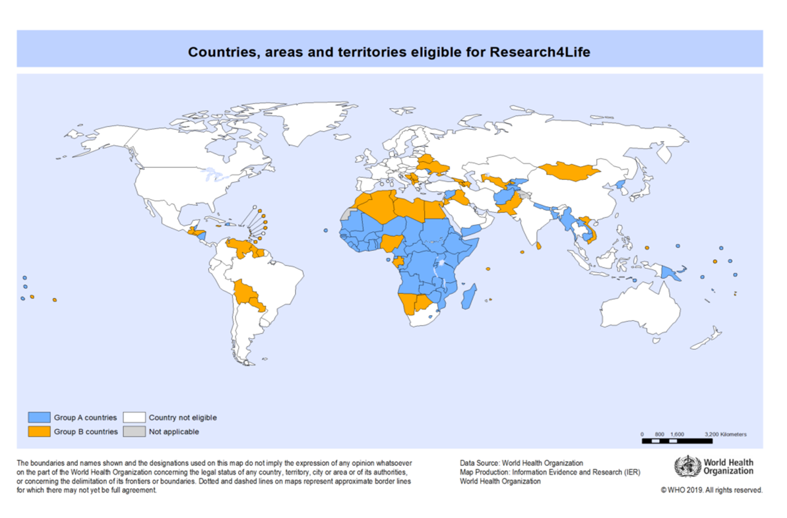
Group A and Group B countries
Group A countries have free access to Research4Life. Group B
countries pay US$1,500 per year to obtain access to the Research4Life.
Countries that are assigned to Group A or Group B are eligible for all Research4Life collections.
Group A
Group B
Not eligible
Not applicable

Slide 5
Registration for Research4Life collections
Individuals are not eligible to register, only institutions are.
Before proceeding to register , please check the list of registered institutions to see if your institution is already registered. If yes, contact the library staff to obtain the institution’s username and password.
If you cannot obtain a registered institution’s login information, contact the Research4Life Helpdesk r4l@research4life.org Include your institution’s name.
If the institution is not registered, a step-by-step guide on how to register online is available at the Research4Life web site
Once the submitted registration form has been reviewed by Research4Life, the applicant will receive an email with further instructions.
For more information on these issues, go to the Research4Life Website and click on the Access drop down menu from the horizontal bar.

Slide 6
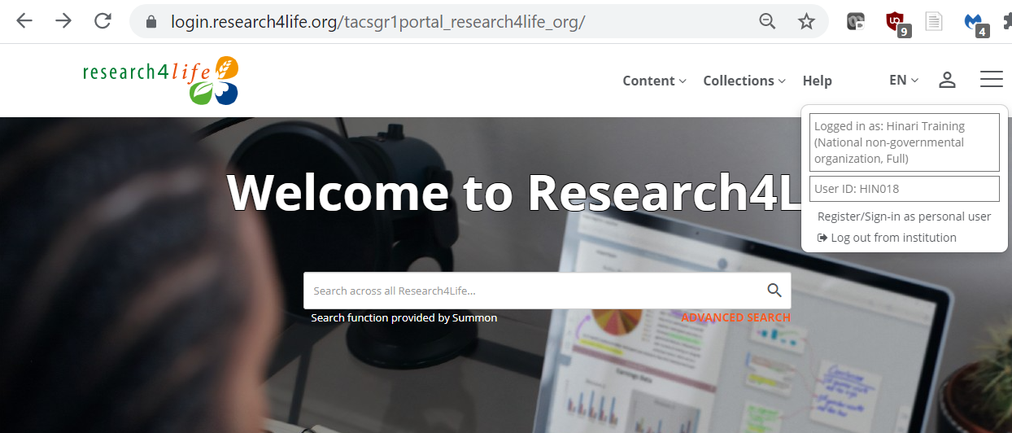
Initial display of the Unified Content Portal
The initial page displays a link to the Summon search box that links to citations and full-text available at your institution.
Click on the person symbol located at the top right corner of the login page to open the login information –in this case, for a Hinari Training: National Non-governmental login; the symbol has changed.

Slide 7
Content and Collections menus
Returning to the Unified Content Portal, the Content and Collections menus are displayed.
In the Content menu, note the options for Journals, Books, Reference Sources, Databases, Free Collections, Publishers, Recent Resources and Subject.
The majority of the content is scholarly that would research projects.

Slide 8
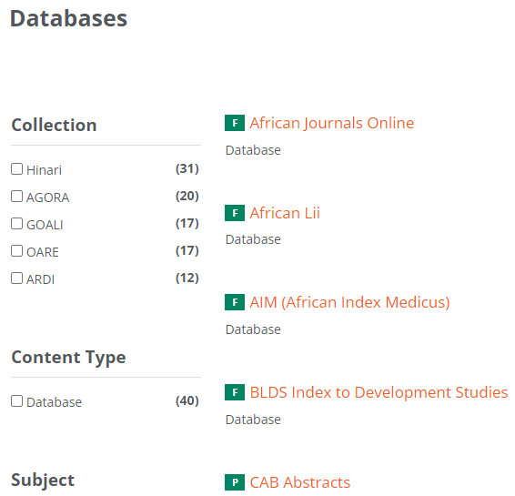
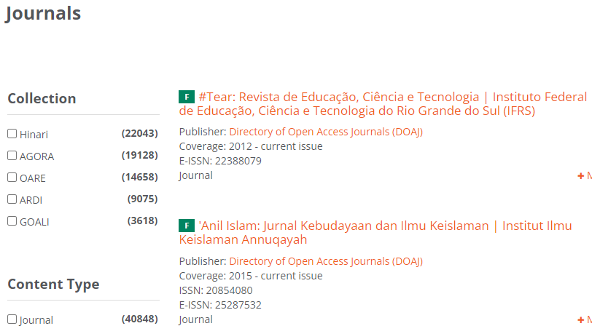
Databases and Journals initial Content pages

Slide 9
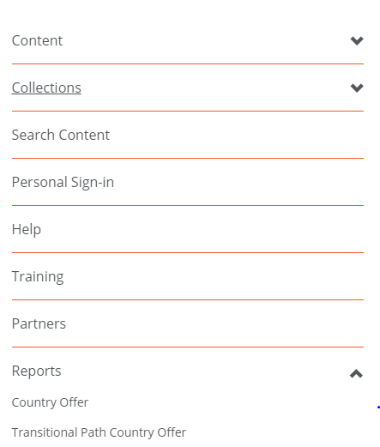
Country Offer
To check the content that publishers have granted access to in a specific country and institution type,
Open the Hamburger Menu.
Click on Reports.
Then click on Country Offer.

Slide 10
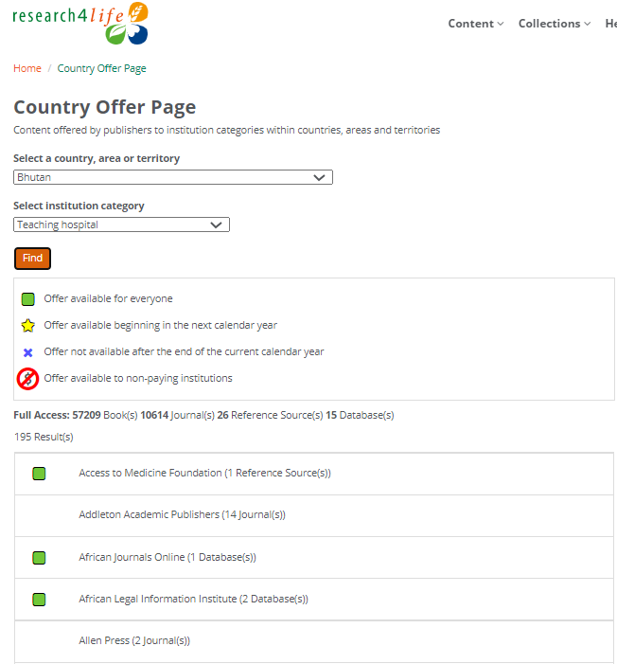
Country Offer continued
Displayed is the Country Offer Page. From the drop-down menu;
Select a country e.g., Bhutan
Select an institutional category e.g., Teaching hospital
Click on Find
Note the code used for the subsequent alphabetical list of Research4Life publishers that are granting access.
For Bhutan, the total access #s are 57209 books, 10614 journals, 26 reference sources and 15 databases

Slide 11
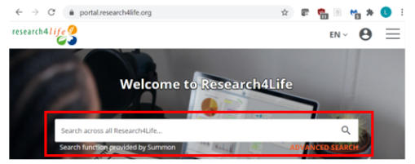
Summon search box
Users can begin Summon searches in the box below the name of any of the three initial Content Portal displays. After opening an option in one of the portals, click on the magnifying glass.
The Search across all Research4Life… note explains that any search will have the same results including full-text links from all Research4Life material regardless of Collection or Portal - that the publishers have granted access to in a specific country/institution.
For this lesson, the Unified Content Portal was used to complete the searches.

Slide 12
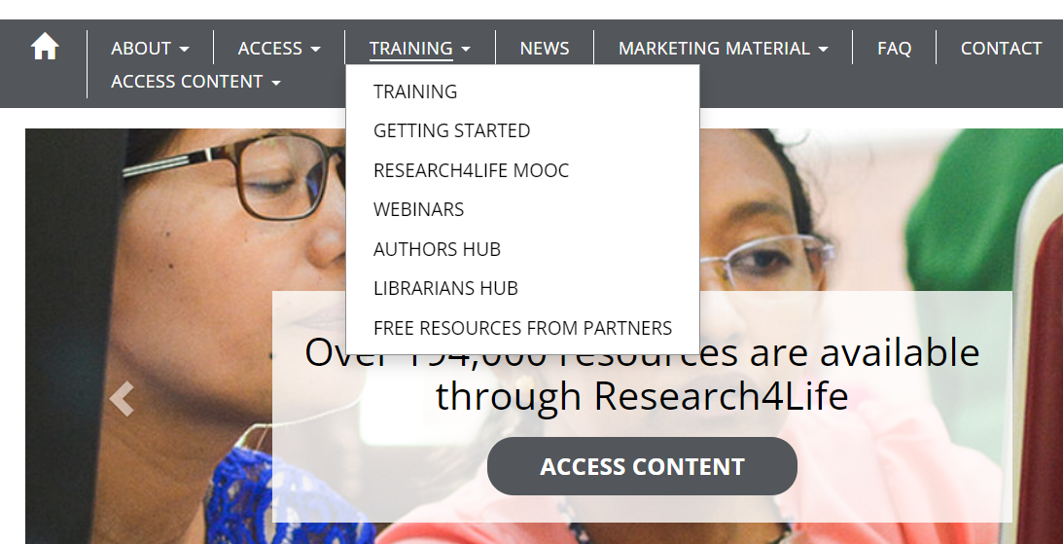
Training material
https://www.research4life.org/
https://www.research4life.org/training/librarians-hub/

Slide 13
Identifying Information Resources: Outline
Information access tool
Types of access tools
Types of Information sources
Scholarly information sources
Evaluating information resources

Slide 14
What is an information access tool?
When starting a research project, it is important to know;
Where to find information.
What type of resources are offered in what kind of access service and platform.
These services and platforms are called access tools. They are utilized to locate different types of information resources.
Please note, not all access tools are free of charge!!!
Always check your library for subscribed collections and tools available in your institution.

Slide 15
Types of access tools
1. Library catalogues & discovery tools – cover the library’s collection including books, journals and any other material, allows one to search across all the subscribed content by library.
2. Databases - provided by the publishers for a fee or free of charge. They can cover articles, book chapters, proceedings and reports. They are particularly useful in finding academic content on specific subjects.
3. Repositories - consist of academic institutions’ output including articles, proceedings, reports and research data e.g.
3. Indexes – these are bibliographic and citation indexes used for literature search as well as finding quality publications. They can be subject-specific or interdisciplinary, & sometimes include a full-text of the publications.
4. Web search engines - they index any type of Internet source harvestable by the engines and provide information users with unlimited Internet sources. Google is the most used web search engine in the world.

Slide 16
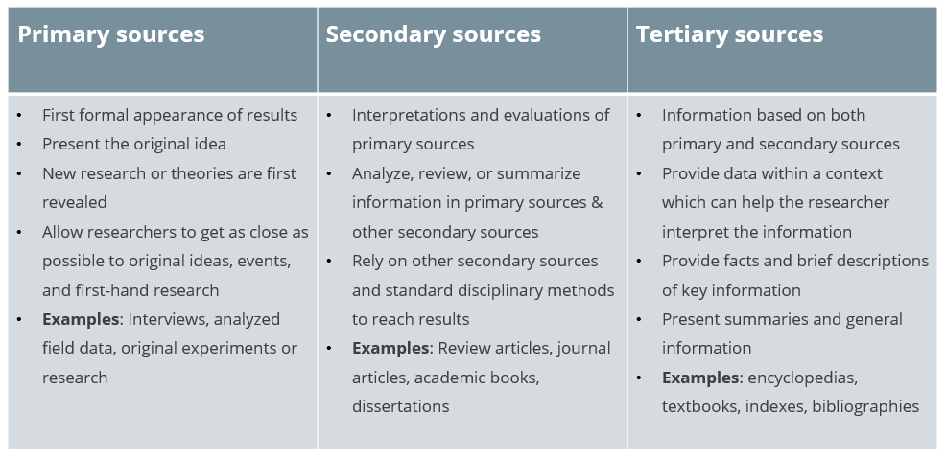
Types of information sources

Slide 17
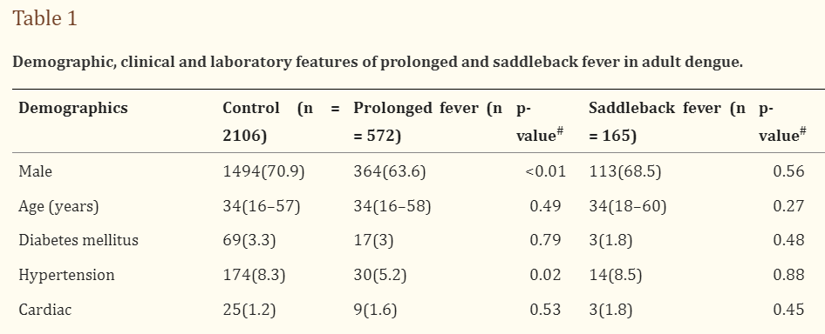
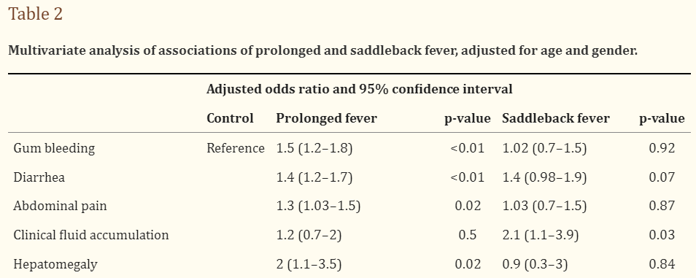
Example: Primary Sources
Source: https://www.ncbi.nlm.nih.gov/pmc/articles/PMC5147856/ Accessed 8 May 2022

Slide 18
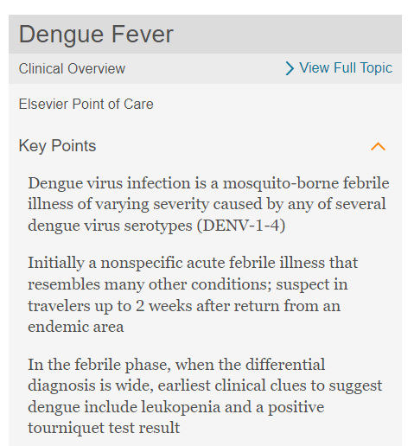
Examples: Secondary and Tertiary Sources
Source: https://pubmed.ncbi.nlm.nih.gov/31448083/ Accessed 8 May 2022
Source: https://www.clinicalkey.com/#!/search/dengue%20fever Accessed 8 May 2022

Slide 19
Scholarly information sources
Academic (peer reviewed) journal is a collection of articles written by scholars and peer reviewed by experts in the field.
Book (monograph): can cover any topic, fact or fiction in a volume. For research purposes, it is better to use books which are subject specific.
Theses/Dissertations: a document containing the author's research and findings and is submitted by a student for an academic degree or professional qualification.
Conference proceedings: are a collection of published papers presented at an academic conference.
Reference materials: refer to encyclopedias, dictionaries and thesauri. They are a collection of short factual entries written by different contributors.
Report (working, technical): is a separately published record of research findings, research in progress or other technical findings.
Patent: is a government authority or license giving a right or title for a set period of time, and the sole right to make, use or sell an invention.

Slide 20
Evaluating information resources
Key areas to consider when evaluating information resources
In today’s internet environment, anyone can be an author. As a result, not all information is reliable or true !
Information resources should be evaluated accurately, particularly when online.
Users must be able to critically evaluate the appropriateness of all types of information sources prior to relying on the information.
Accuracy
Authority
Objectivity
Coverage
Currency

Slide 21
1. Authority
Who is the author?
Is the author affiliated to a reputable university or organization?
What is the author's educational background or experience?
What is their area of expertise?
Has the author published in academic or peer reviewed publications?
Does the author/Web Master provide contact information?

Slide 22
2. Accuracy
Is the information provided based on proven facts?
Is it published in an academic or peer-reviewed publication?
Can you find when it was last updated?
Is there an editor or someone who verifies/checks the information?
Is the page free of spelling mistakes or other obvious problems?

Slide 23
3. Objectivity
How objective is the information?
What do you know about who is publishing the information?
Is there a political, social or commercial agenda?
Does the information try to inform or persuade in an inappropriate way?
How balanced is the presentation in opposing perspectives?
What is the tone of language used (angry, sarcastic, emotive, objective)?

Slide 24
4. Coverage
Does the information covered meet your information needs?
Is the coverage basic or comprehensive?
Is there an "About Us" link that explains subject coverage?
Is the information relevant to your topic?
Does this page have information that is not found elsewhere?
How in-depth is the material?

Slide 25
5. Currency
When was the information published?
When was the web site last updated?
Is timeliness important for your information needs?
Are the links up to date and do they point to existing pages?

Slide 26
References and useful resources: Identifying Information Resources
Becksford, L. 2021. Research Guides: Getting Started with Academic Research: Developing a Topic. In: Virginia Tech University Libraries [online]. [Cited 9 July 2021]. https://guides.lib.vt.edu/gettingstarted/topic
Cook, R. 2019. Step 2: Identifying Information Sources: Library Skills. In: University of Michigan Library [online]. [Cited 9 July 2021]. https://umich.instructure.com/courses/83460/pages/step-2-identifying-information-sources
Teaching & Learning, Ohio State University Libraries. 2015. Primary, Secondary & Tertiary Sources. In Choosing & Using Sources: A Guide to Academic Research. The Ohio State University. (Also available at https://ohiostate.pressbooks.pub/choosingsources/chapter/primary-secondary-tertiary-sources/)
T

Slide 27
Using Information Resources: Outline
Literature search
Search strategies
Refining a search
Literature search cycle
Search filters
Boolean operators
Parentheses and wildcards
Search limits
How to formulate a research question

Slide 28
What is a literature search?
A literature search involves finding out what other work has already been done in the field in which you focus.
"Literature search is a systematic and well-organised search from the already published data to identify a breadth of good quality references on a specific topic… The main purpose of a thorough literature search is to formulate a research question by evaluating the available literature with an eye on gaps still amenable to further research.”
Source: https://www.ncbi.nlm.nih.gov/pmc/articles/PMC5037943/ Accessed 8 May 2022
There are various search strategies for carrying out a literature search, mainly depends on the stage of your research.

Slide 29
1. Simple search - basic search
This is a quick and first step search for online resources.
Usually done through Google Scholar, university library’s catalogue or Wikipedia .
One can search by typing in a single search term or phrase
One can also search by typing part of bibliographic record e.g., title or journal name into the search engines to get the full bibliographic information.

Slide 30
2. Systematic search - building a query
Requires a more comprehensive search strategy.
Usually done for a complex piece of research which aims to identify, select and synthesize all research published on a particular question or topic.
A systematic research consists of identifying search items, using boolean operators, advanced search techniques and building a query.

Slide 31
3. Following a thread - snowballing
Snowballing involves using a key publications on your subject as a starting point.
The references listed in your relevant publications lead you to other relevant publications.
The snowball method helps to find a lot of literature about a subject quickly and easily.
related publication
related publication
related publication
Key publication
related publication
related publication
related publication

Slide 32
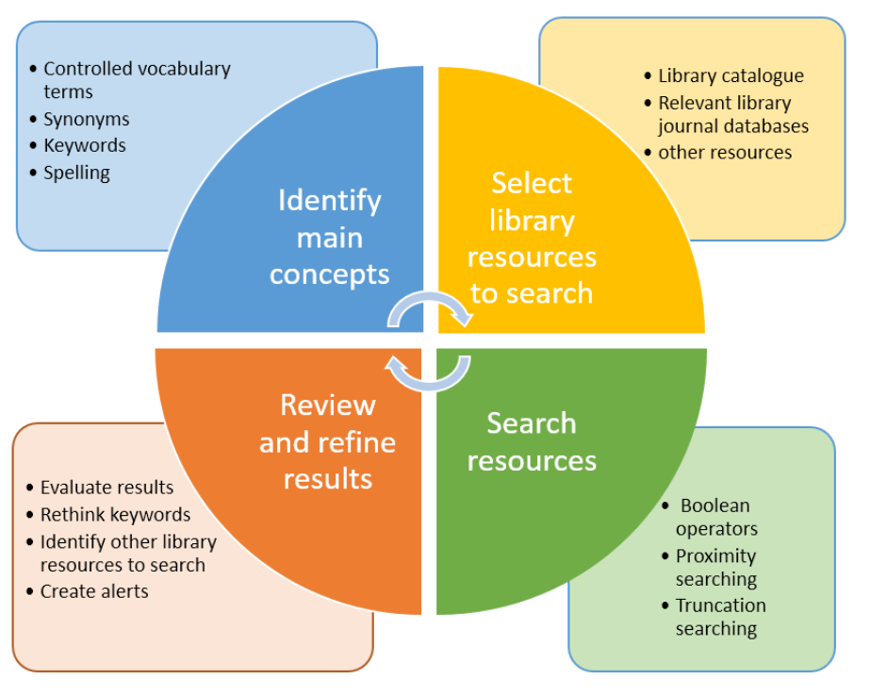
Literature search cycle
Source: https://libguides.csu.edu.au/review/Search_Strategies Accessed, 6 May 2022

Slide 33
What you should do!
Collect background information in order to get an overview on the topic.
An encyclopedia provides a good start.
Newspapers & professional journals are useful for familiarizing yourself with current developments and opinions.
Books & review articles provide an introduction and overview of various aspects of the topic.
Narrow your focus.
Turn your research focus into a question
The 4W+H questions are a great way to start: What ? Where? Who? Why? How?

Slide 34
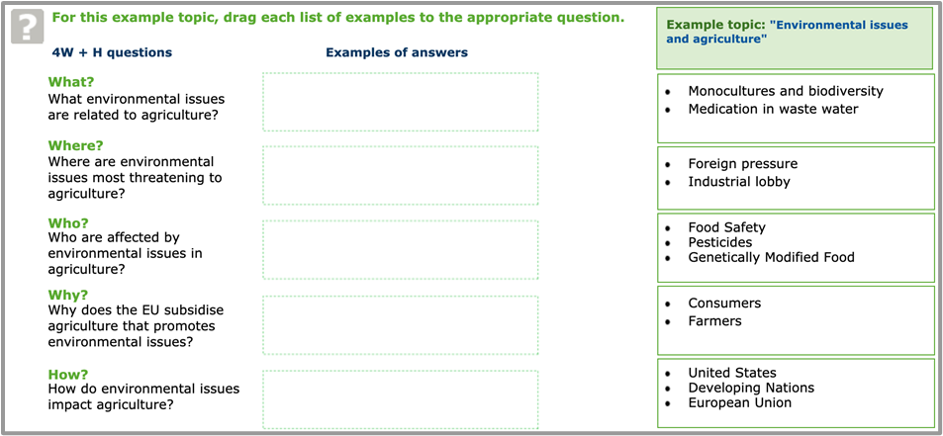
The 4W+H questions
The given example topic is “environmental issues and agriculture”
Source: https://library.wur.nl/infoboard/module_2/page14872.html Accessed, 7 May 2022

Slide 35
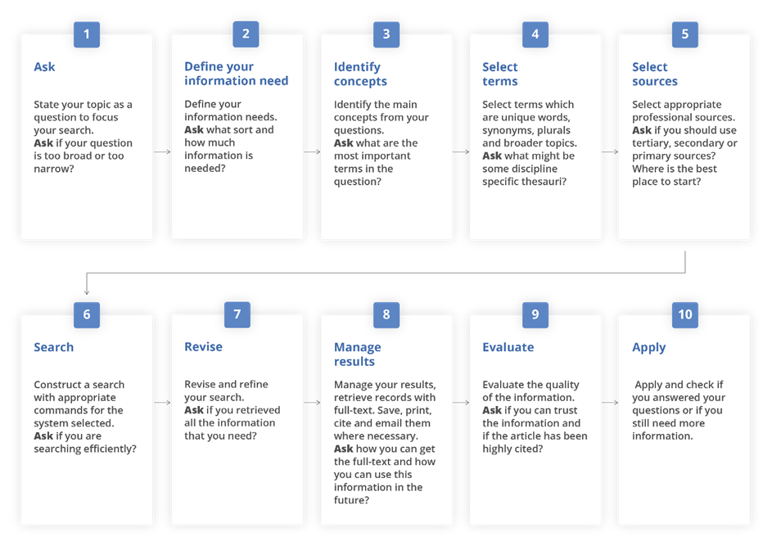
Developing a search strategy: Process overview
Source: https://www.who.int/hinari/training/Basic_Course/en/ Accessed 24 January 2022

Slide 36
Refining a search
Think critically and judge what information is relevant and appropriate for your purpose.
A filter enables you to refine your search criteria further, by adding some additional search criteria.
A filter can be applied before running a search or it can be used to refine search results after the initial search has been executed.
“There is no such thing as the perfect search…”

Slide 37
Search filters
Search filters are used to evaluate & improve search queries appropriate information is retrieved.
A simple search retrieves thousands of records, try different search strategies to get pertinent results.
E.g. A search on a broad topic such as “globalization” or “organisational behaviour”, will receive too many results. Use a connected string words to retrieve a more manageable list.
Repeat the process to find the best match.
Remember that all search strategies do not function the same way in all databases.

Slide 38
Boolean operators
Boolean search operators (AND, OR, NOT) connect terms and locate records containing matching terms.
They strengthen the relevancy ranking in your search results.
Booleans Operators can allow you to either narrow, broaden or exclude search results.
AND operator is used to combine two or more concepts and narrows a search.
OR operator is used to contain one or other terms and broadens a search.
NOT operator is used to exclude one or other terms and narrows a search.

Slide 39
Parentheses and wildcards
These help to narrow your results and make your search more specific.
Phrase or proximity searching | “…” or (…) allows you to search for an exact phrase “crop plantation” and (soil condition)
Truncation/wildcards | * or $ allow you to search for alternative spellings child* for child OR childs OR children parasite* for parasite OR parasites
Alternate spellings | ? can be used to substitute for characters anywhere in a word wom?n would search for “woman” and “women”

Slide 40
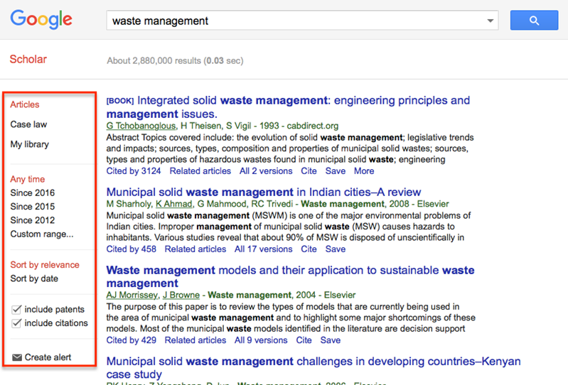
Search limits
Most databases & search platforms allow you to limit a search by author, title, journal, date, and language etc
You can use an advance search and refine your options on a search platform.
Drop down menus are available.

Slide 41
References and useful resources: Using Information Resources
Charles Sturt University. Library. Literature Review: Developing a search strategy . https://libguides.csu.edu.au/review/Search_Strategies [Cited 6 May 2022]
George Mason University, The Writing Center, How to write a research question. [online] [Cited 6 May 2022] https://writingcenter.gmu.edu/guides/how-to-write-a-research-question
Grewal, A, Kataria, H, Dhawan, I. Literature search for research planning and identification of research problem. Indian J Anaesth 2106 Sep; 60(9) https://www.ncbi.nlm.nih.gov/pmc/articles/PMC5037943/ [Cited 8 May 2022]
Literature Search: a librarian’s handout to introduce tools, terms and techniques. https://libguides.csu.edu.au/ld.php?content_id=36285749 [Cited 6 May 2022]
Ratan, S, Arnaud T. Ratan, J Formulation of a Research Question – Stepwise Approach. J. Indian Basic Pediatr Surg. Jan-March 2019 , 24,(1) 15-20 https://www.ncbi.nlm.nih.gov/pmc/articles/PMC6322175/ [Cited May 7 2022]
University of Leeds Library. 2021. Literature searching explained. In: University of Leeds [online]. [Cited 9 July 2021]. https://library.leeds.ac.uk/info/1404/literature_searching/14/literature_searching_explained/
WUR. 2020. The 4 W’s. In: Wageningen University & Research Library [online]. [Cited 9 July 2021]. https://library.wur.nl/infoboard/module_2/page14872.html

Slide 42
Questions & Answers discussion
Please submit any questions via chat

Slide 43
Arriving at your research question
Step 1: What is my area of research?
Step 2: What is known so far in this area?
Step 3: What is not known in this area?
Step 4: Which unknowns do I want to focus on in my research?
To reach the third step, you need to do an extensive literature survey. Here is where a recent review article can really save you time! You may find that there are a lot of unknowns in a particular area. What is unknown could be a gap in knowledge, so it could be an opportunity for you to address it! But that doesn't mean every unknown thing is important or relevant.
INASP, AuthorAID programme. The online course: Research Writing in the Sciences. Oxford, United Kingdom; 4 September - 29 October 2018. Lesson 1b "Arriving at your research question"

Slide 44
Identifying relevant unknowns
A typical scientific research paper addresses one or at most a few research questions or hypotheses.
Recall the four steps mentioned in the previous slide. The fourth step was: "Which unknowns do I want to focus on?"
Consider the following to answer this question:
Why is it important to address a particular unknown or gap? What contribution will it make to the knowledge or practice in your field?
Would your investigation into a particular unknown be relevant for an academic journal?
Do you have the means (knowledge, people, funding) to direct your research to explore this unknown?
INASP, AuthorAID programme. The online course: Research Writing in the Sciences. Oxford, United Kingdom; 4 September - 29 October 2018. Lesson 1b "Arriving at your research question"

Slide 45
How to formulate a research question
A research question is the question around which you center your research. It should be:
clear: it provides enough specifics that one’s audience can easily understand its purpose without needing additional explanation.
focused: it is narrow enough that it can be answered thoroughly in the space the writing task allows.
concise: it is expressed in the fewest possible words.
complex: it is not answerable with a simple “yes” or “no,” but rather requires synthesis and analysis of ideas and sources prior to composition of an answer.
arguable: its potential answers are open to debate rather than accepted facts.
Source https://libguides.umgc.edu/c.php?g=709287&p=5388855.Accessed, May 6, 2022

Slide 46
Exercise in choosing a clear and specific research question
A research question is a clear and specific question that forms the basis of your research project.
Three examples of research questions are given below. Try to identify the question that is the most specific:
What types of pesticides might bees be exposed to in major crops?
Are honey bees exposed to pesticides in major crops?
What happens when bees are exposed to pesticides?
INASP, AuthorAID programme. The online course: Research Writing in the Sciences. Oxford, United Kingdom; 4 September - 29 October 2018. Lesson 1b "Arriving at your research question"

Slide 47
Research question checklist
Is it an open-ended question?
Is it appropriate in scope? Focused and narrow enough for your project?
Does it suggest factors that can be measured?
Is it relevant to my audience?
Is answering the question manageable and can I find enough documents, statistics or person to provide information to develop and support the ideas?
Is the topic of interest to me?
Source https://libguides.umgc.edu/c.php?g=709287&p=5388855.Accessed, May 6, 2022

